Slide 1
Renato Viveiros Freitas
Data Analysis
Final Project - Python Foundation - ReDi School of Digital Integration

Slide 2
Introduction
Challenge as part of a job application process for the position of Business Analytics Intern at the Health Tech company
About health appointments (patient - clinic)
Appointments.csv (appointment id, practitioner id, patient id, clinic id, appointment date)
Revenues.csv (appointment id, revenue)

Slide 3
Tasks
1 - How much revenue can be expected in 2023?
2 - How many unique patients will have been acquired by the end of 2023?

Slide 4
Premises
Two existing clinics in 2022
New clinic in March 2023
New clinic in July 2023
Existing clinics will keep running in 2023

Slide 5
Task 1 - How much revenue can be expected in 2023
Steps to complete the task:
Exploratory analysis - head(); describe(); info(); shape
Join and merge csv files into a new dataframe - pd.merge
Data manipulation - transform date column type into datetime; create new columns for year, month and day
Calculate the sum of each existing clinics’ revenue and get the average between them in each month
Stipulate how much revenue can be expected in 2023 based on the average of the two existing clinics and the opening clinics months

Slide 6
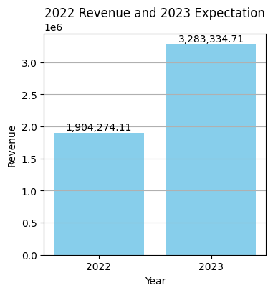
Represents an increase of 72% in revenue

Slide 7
Task 2 - How many unique patients will have been acquired by the end of 2023
Steps to complete the task:
Calculate the sum of each existing clinics’ unique patients
.loc
nunique()
Calculate the average of unique patients between the two existing clinics
Stipulate how many unique patients can be expected in 2023 based on the average of the two existing clinics and the number of open months for each new clinic

Slide 8
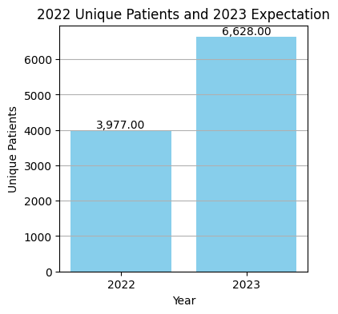
Represents an increase of 67% in unique patients acquired

Slide 9


Slide 10
Thank you!

